Slide 1
Airbnb Price Prediction
By Prerna Kapoor

Slide 2

Overview
Online marketplace for lodging, primarily homestays for vacation rentals, and tourism activities.
Airbnb dataset from Los Angeles, California, USA is gathered for the supervised learning problem.
The dataset consist of several features such as host name, host URL, number of reviews, number of beds, number of accommodates, availability, review score, etc.

Slide 3







Problem Statement
What predicts the Airbnb price?
Number of beds?
Number of guest allowed?
Review score?
Location?
Neighborhood?
Type of property?
Type of room?

Slide 4



Insights
Benefits the host looking to maximize their profit.
Anyone who wants to start Airbnb business in Los Angeles.
Approach/Models
Regression and Prediction
Linear Regression
Decision Tree regressor
Random forest regressor

Slide 5
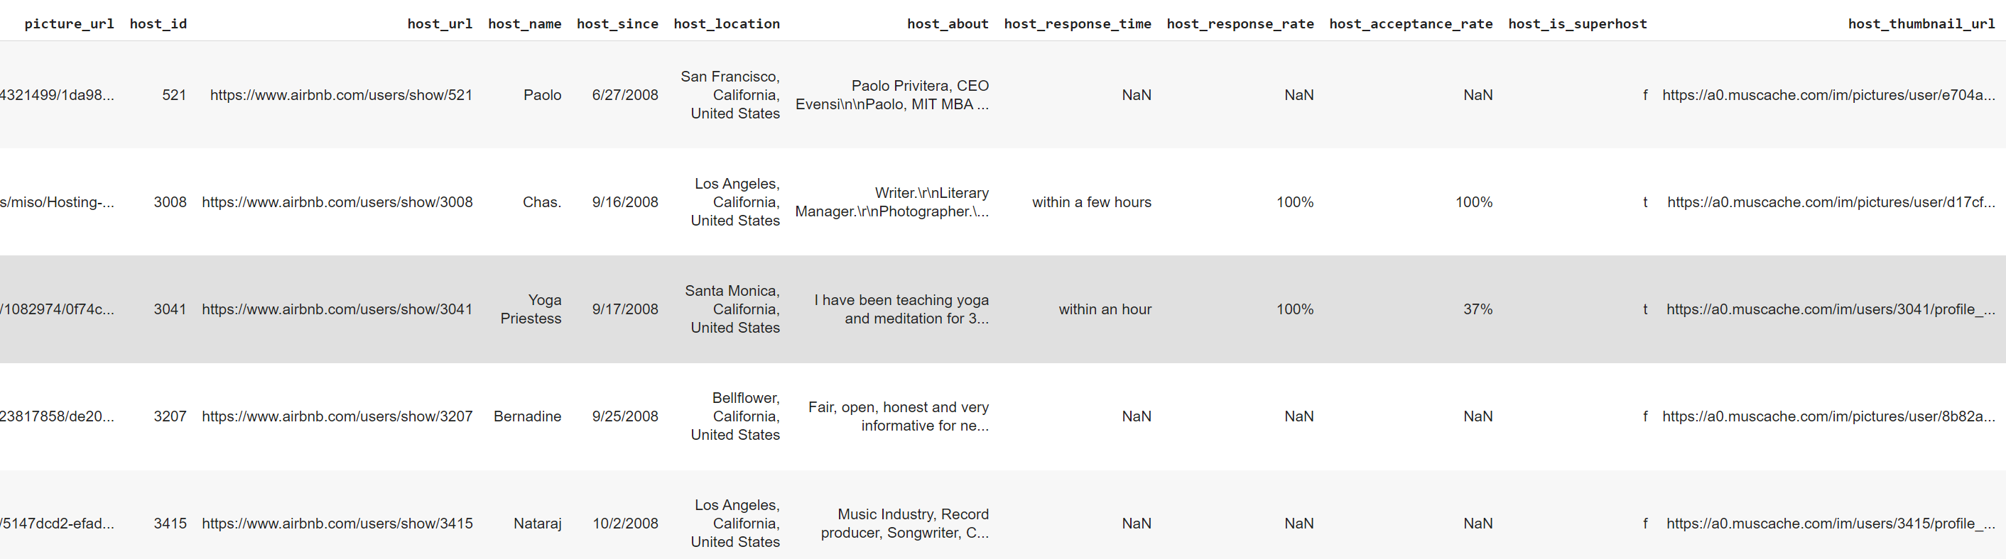
Airbnb Listing Table
Number of Rows: 33,329
Number of Columns: 73

Slide 6
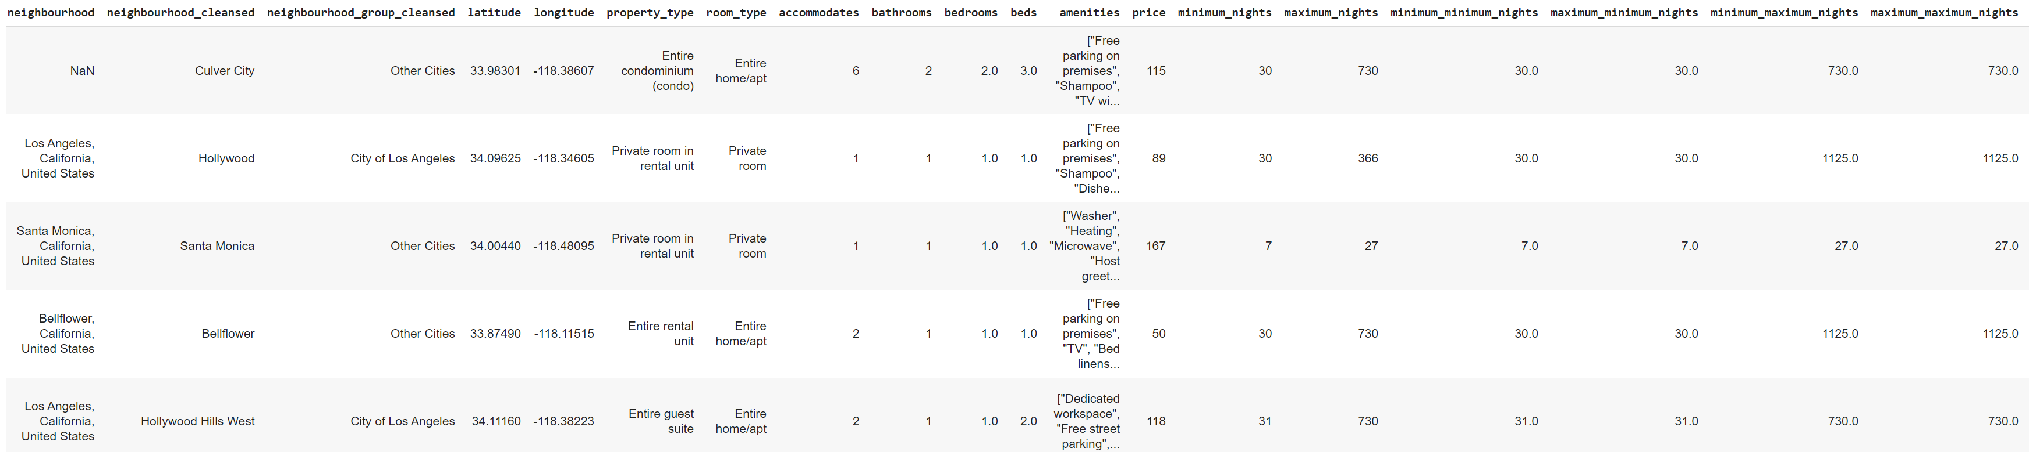
Airbnb Listing Table cont.

Slide 7
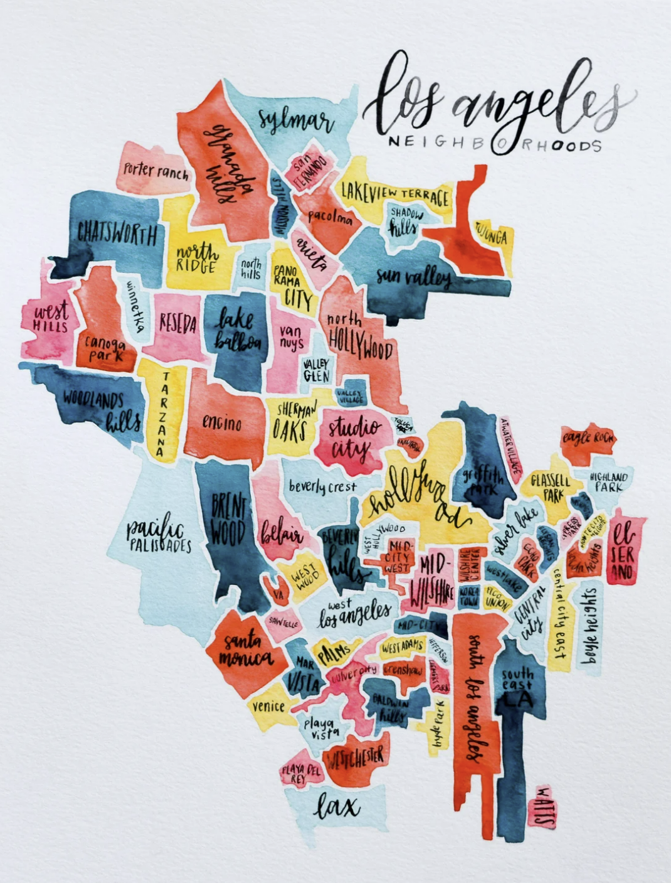
Airbnb in Los Angeles
Host Location consist of cities other than Los Angeles cities, e.g. San Francisco, some other countries like Mexico, India, China.
Selecting only the cities that come under Los Angeles, California, USA.
Approx. 10k host locations were removed.

Slide 8
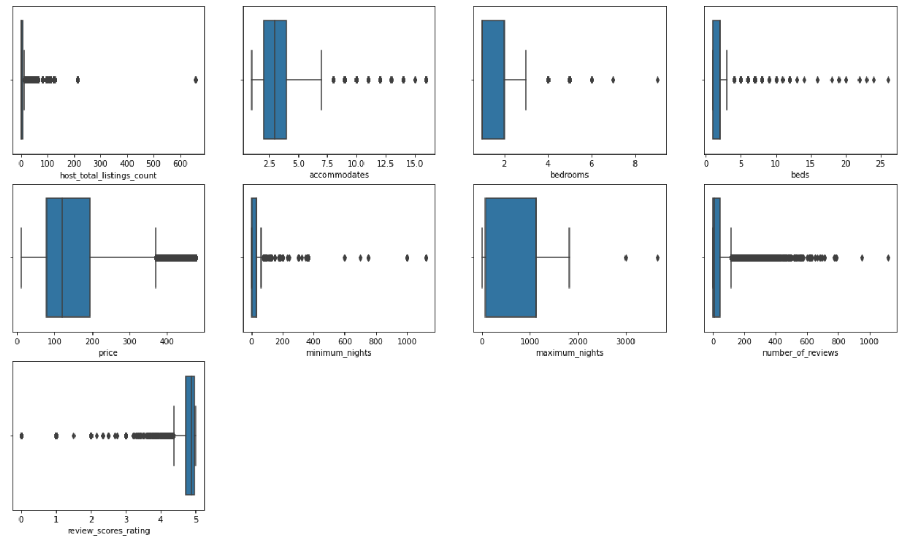
Handling Outliers and Missing values
Inter Quartile Range (IQR) is used to remove outliers.

Slide 9
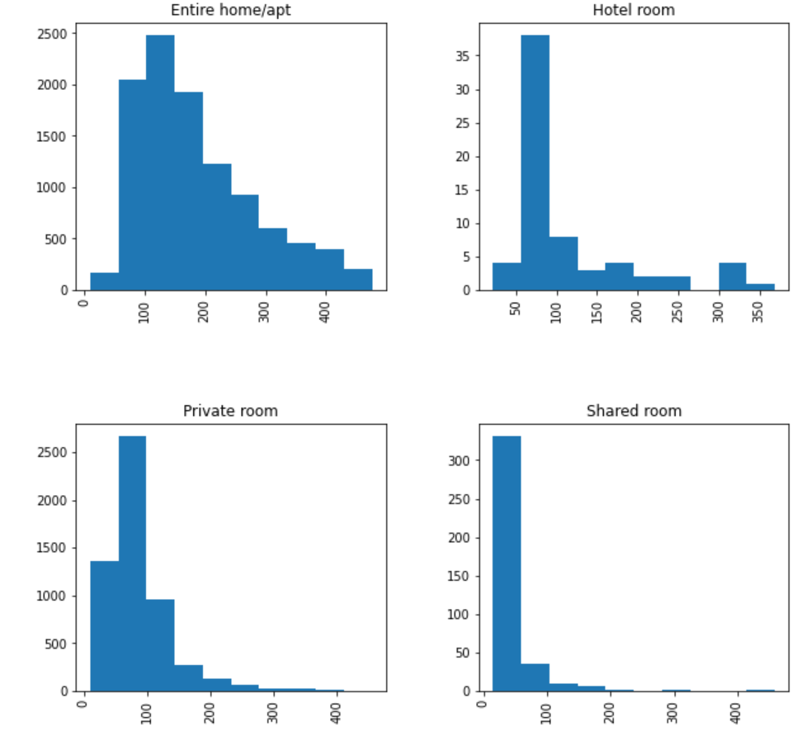
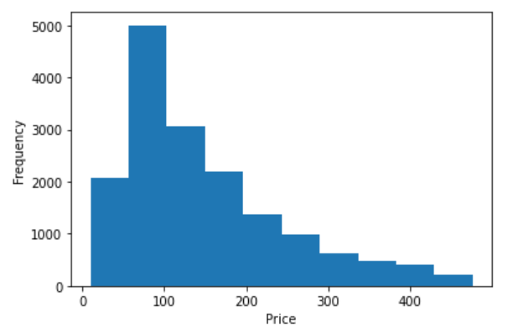
Price Distribution

Slide 10
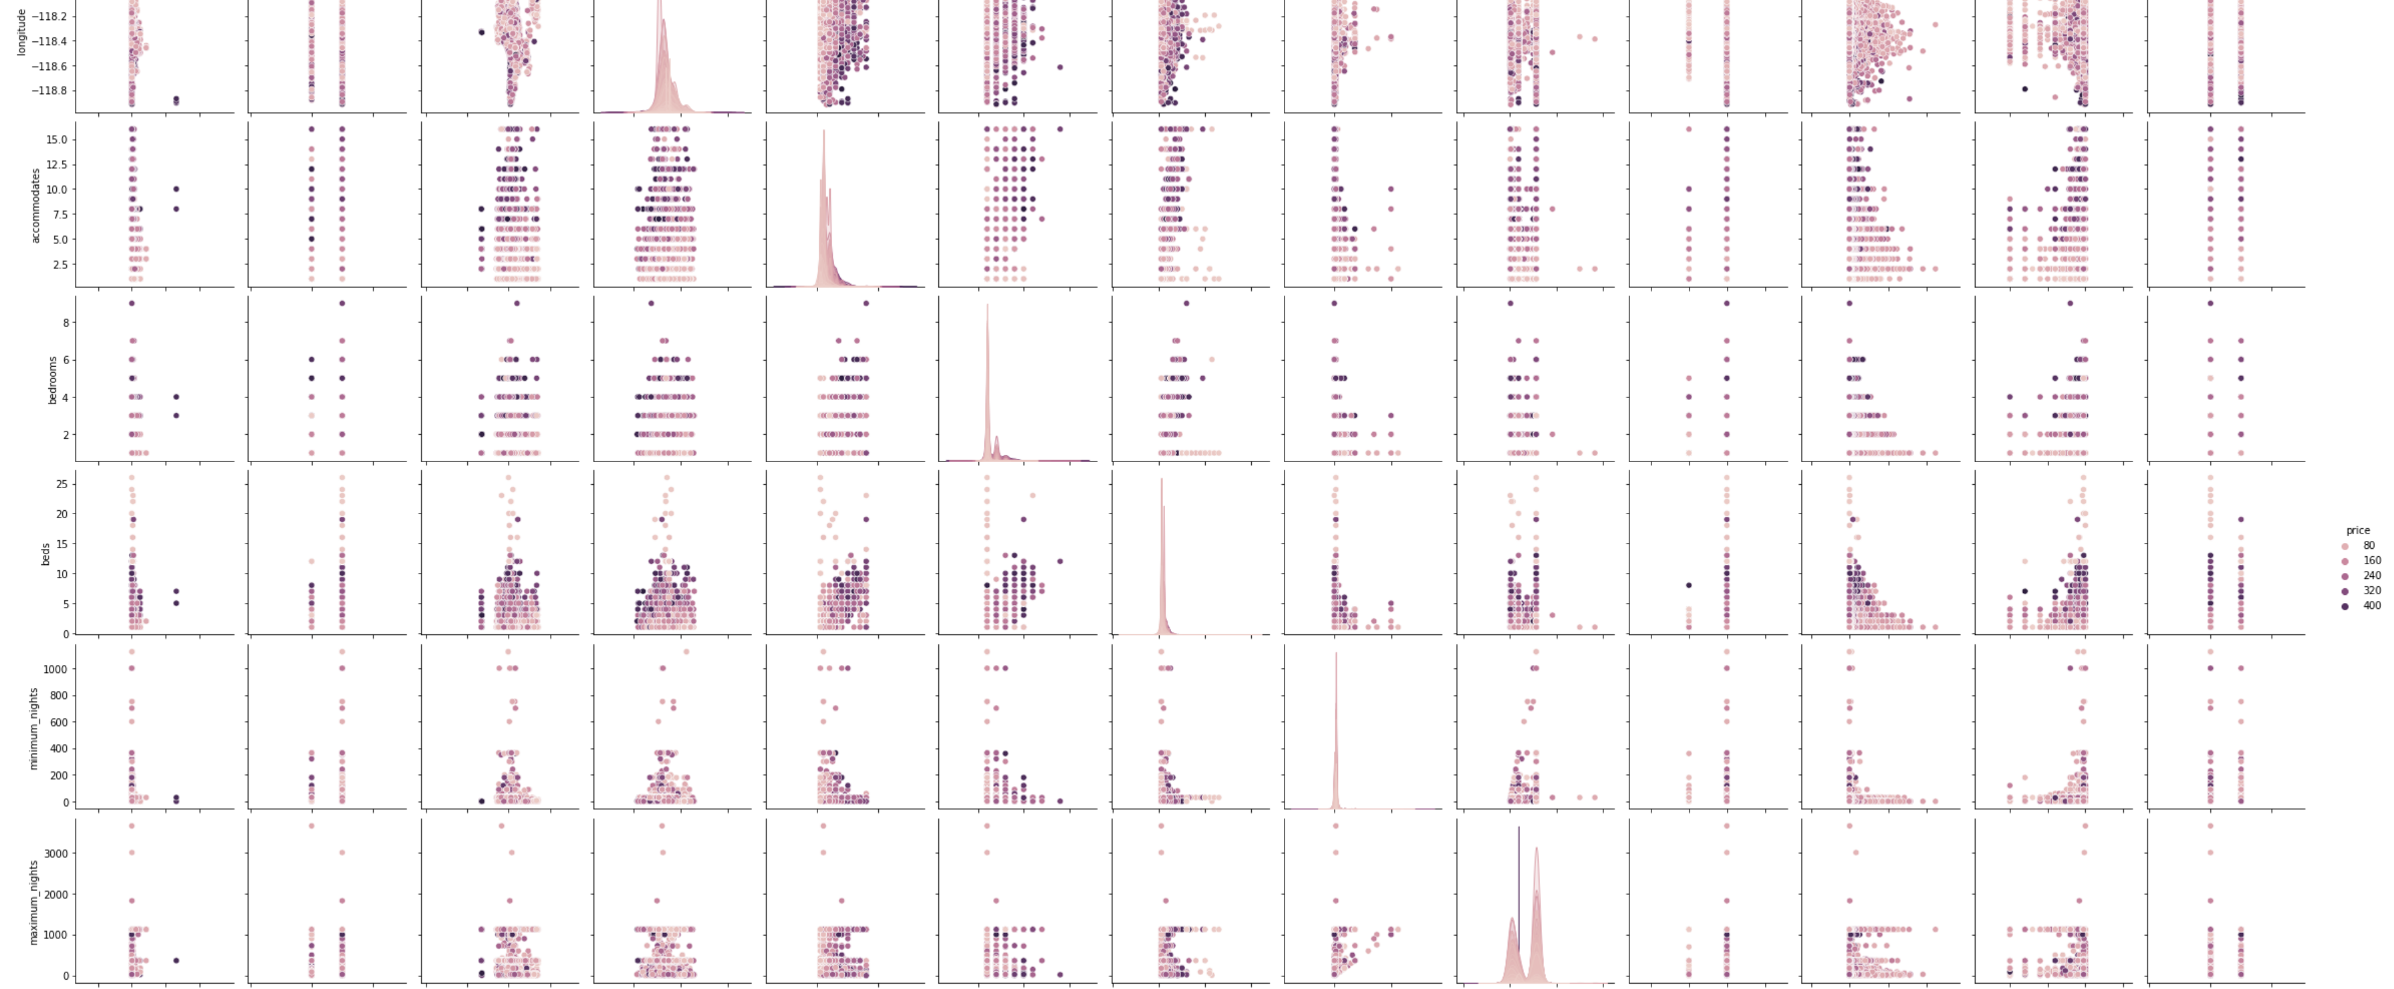
Visualizing relationships among variables

Slide 11
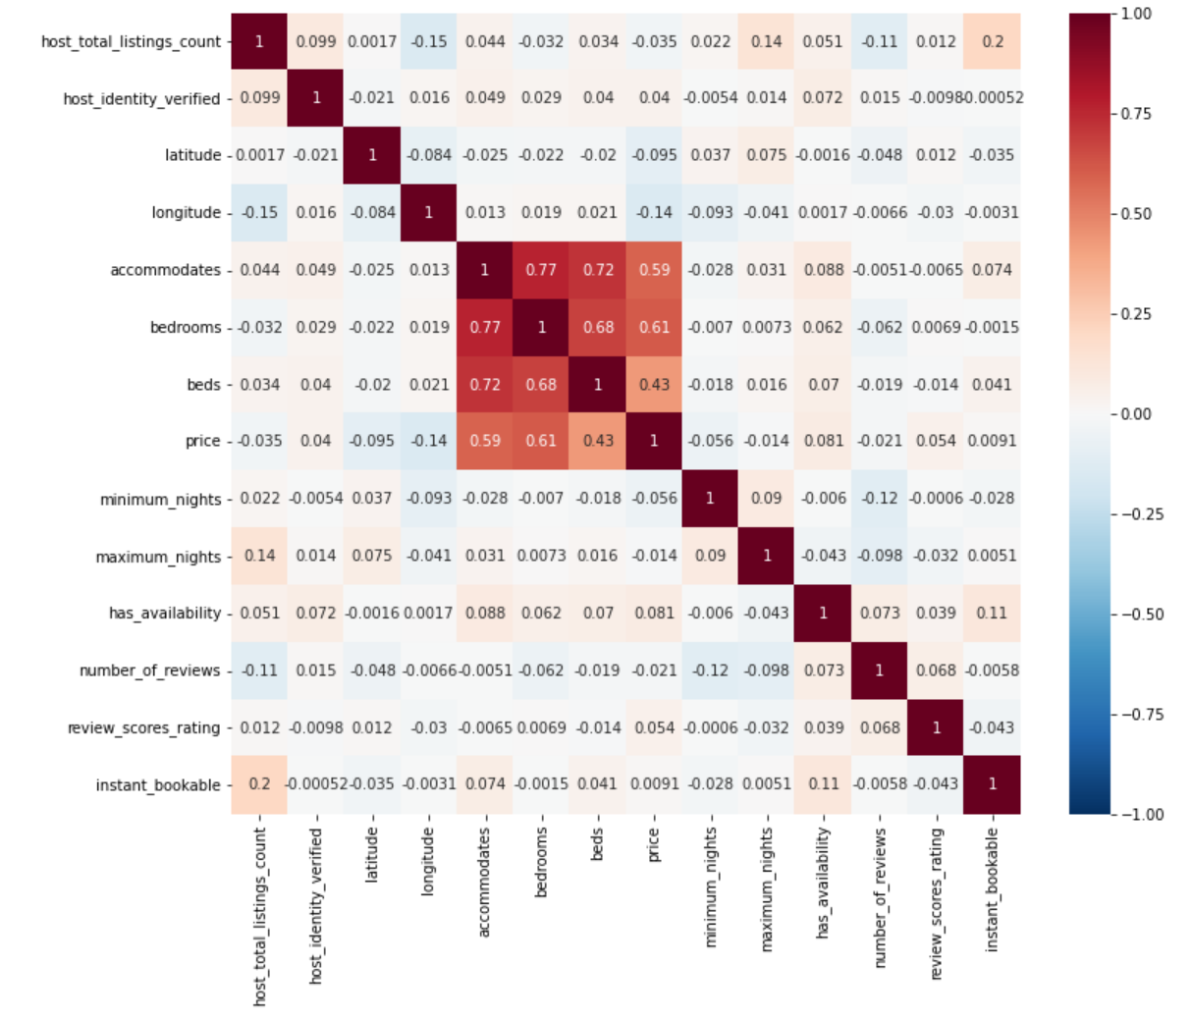
Heat map to analyze Correlation among Features

Slide 12
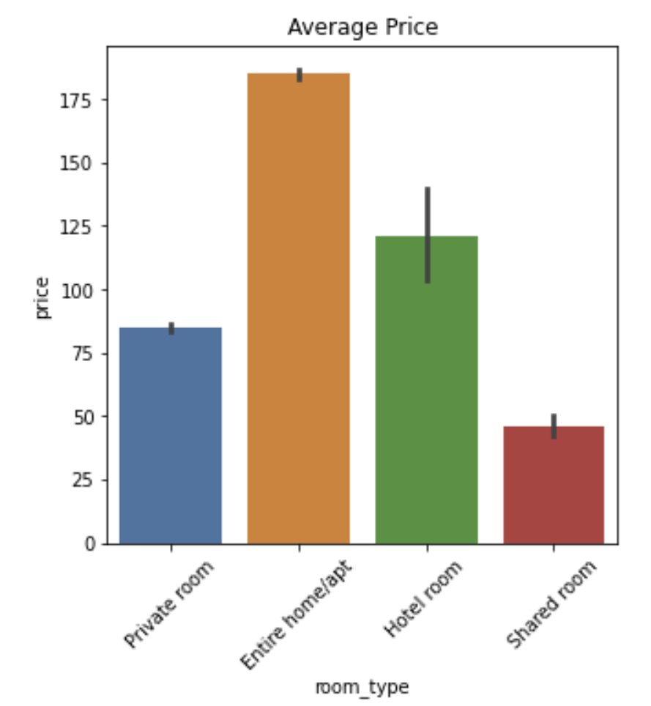
Price Distribution based on Room Type

Slide 13
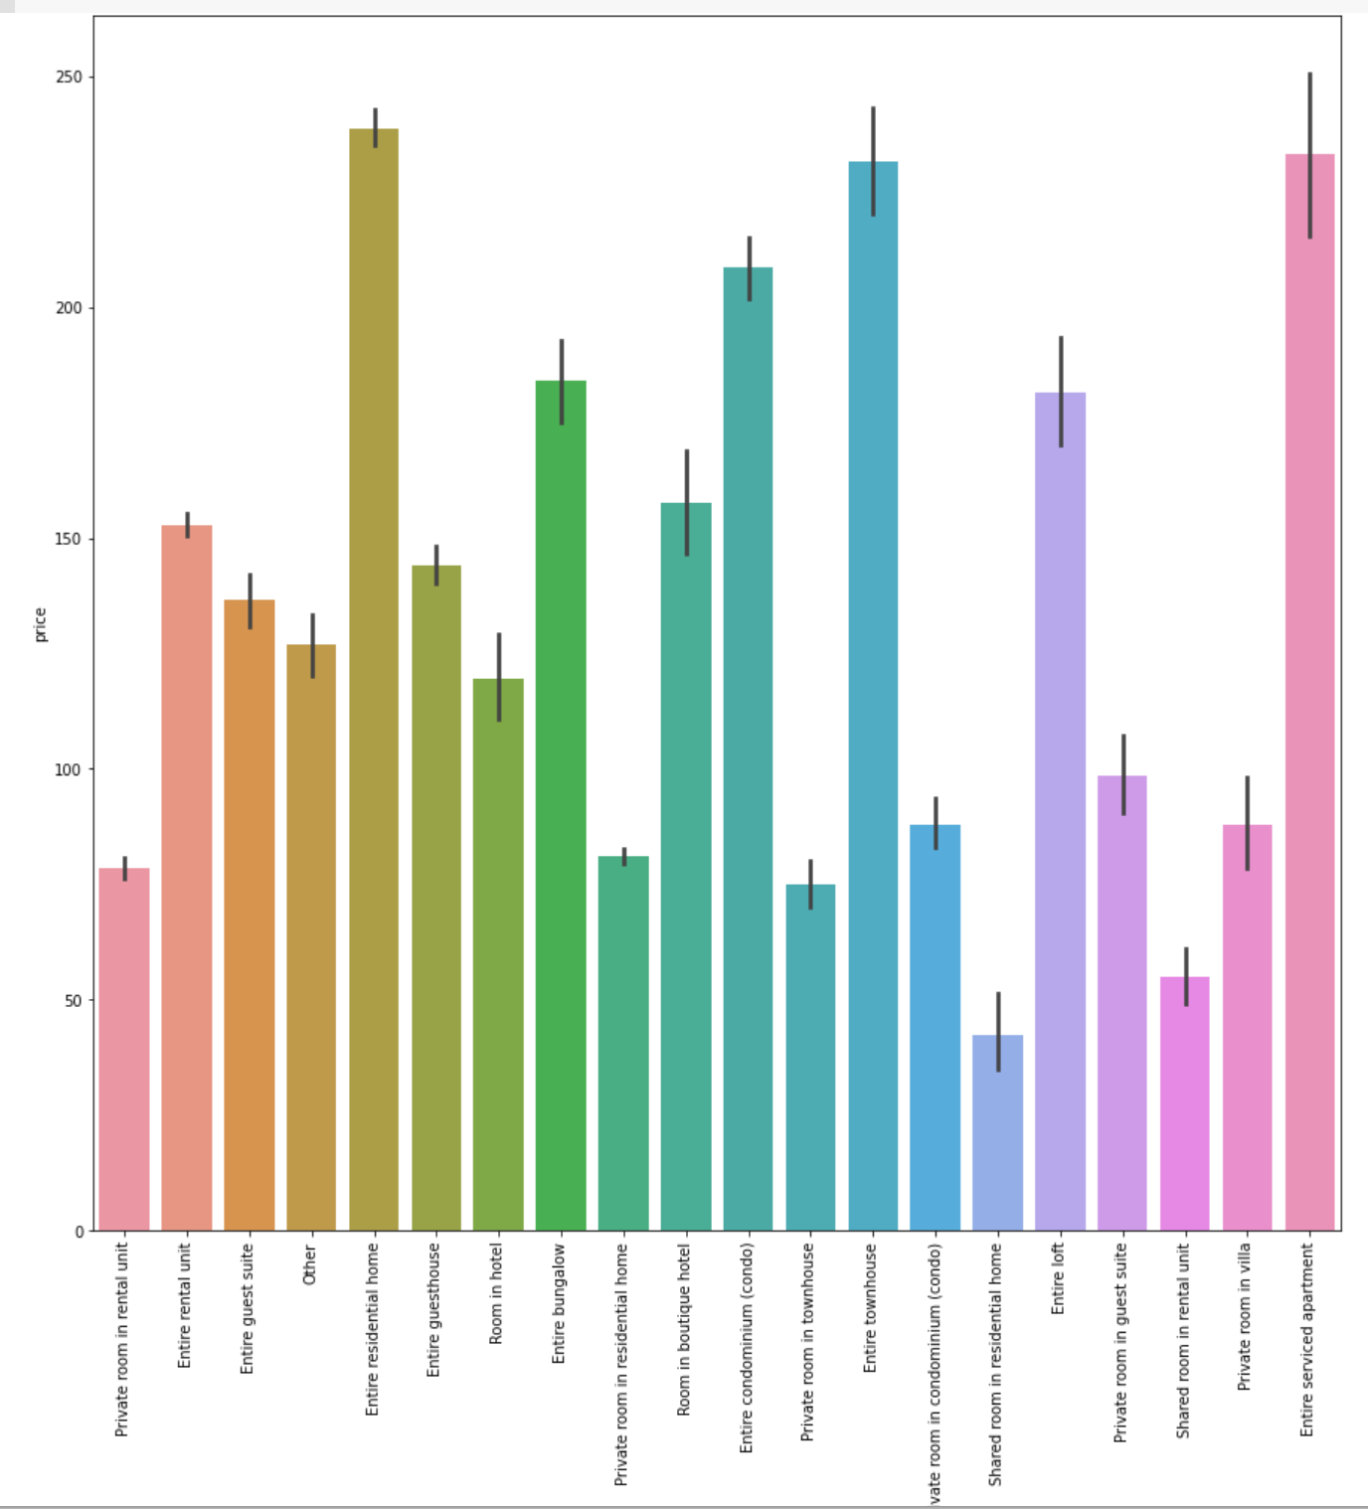
Price Distribution based on Property Type

Slide 14
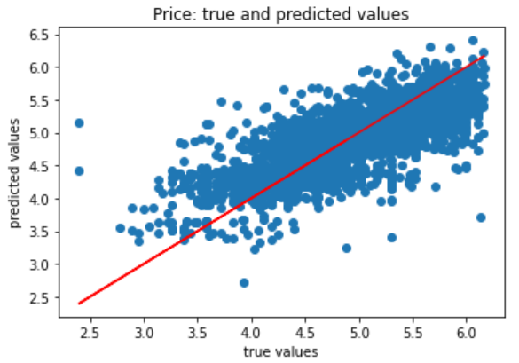
Linear Regression Model
R-squared of the model in training set is: 0.57
R-squared of the model in test set is: 0.56
Features significantly contributing to the model are review_score_rating, bedrooms, property_types etc., having p-value < 0.05.
Insignificant features like maximum_nights, has_availability, instant_bookable have p value more than 0.05., does not contribute to the model.

Slide 15
Decision Tree Regression
Decision tree builds regression or classification models in the form of a tree structure. It breaks down a dataset into smaller and smaller subsets while at the same time an associated decision tree is incrementally developed. The final result is a tree with decision nodes and leaf nodes.
Random Forest Regression
A random forest is a meta estimator that fits a number of classifying decision trees on various sub-samples of the dataset and uses averaging to improve the predictive accuracy and control over-fitting.

Slide 16
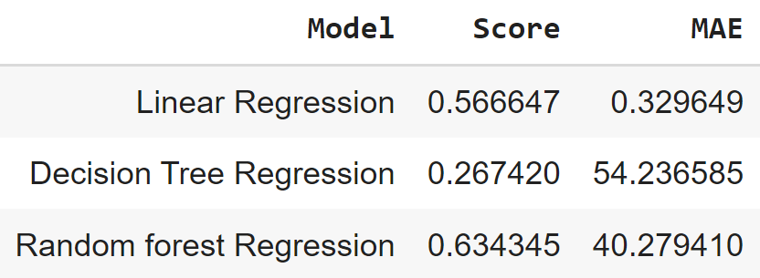
Performance
Linear Regression model defines 57% variance in the target variable.
Random Forest Regression model defines the 63% variance in the target variable.
Decision tree regression model defines only 27% variance in the target variable and 73% of the variance is not defined.
Random Forest Regression model is best among the three models used here as it explains 63% variance in the target variable.

Slide 17
Uses
Airbnb prediction model predicts the price of the Airbnb rental in Los Angeles depending on the host total listings, latitude, longitude, number of bedrooms, minimum nights, number of reviews, review score rating, property type and room type.
Property type like "Entire residential home" and "Entire serviced apartment" provide maximum profits than other property types.
The host who wants to start Airbnb business should provide "Entire home/apt" for Airbnb as it would leads to most of the revenue as compared to renting “shared room”.

Slide 18
Recommendations
Improving the performance of the model, by adding more features to the model.
Hosts can maximize their profits by knowing the best times throughout the year and locations to put the Airbnb into market for people to use it.
Identify suitable guests for the Airbnb depending on the location. Example, if host are seeking business travelers from the corporate world, or is host property near local attractions such as an amusement park or historic site.
Airbnb gets booked faster so it does not stay unoccupied in market for a long time.

Slide 19
THANK YOU

